Slide 1
Power Management System
Name: Muhammad Zulhafiz Bin Zulkifli
Matric No: 1812661

Slide 2
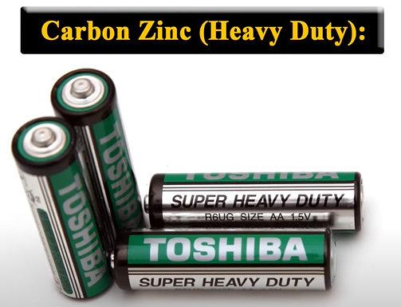
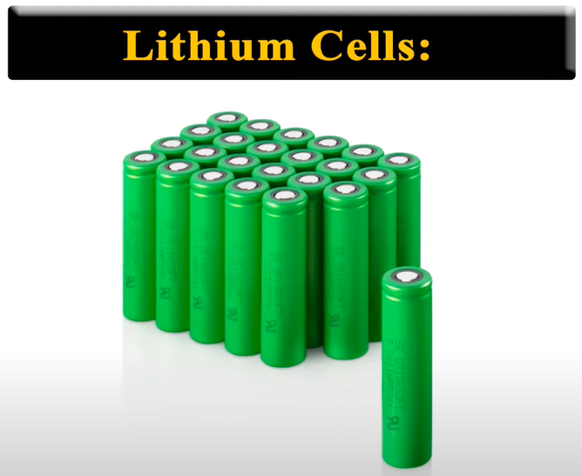
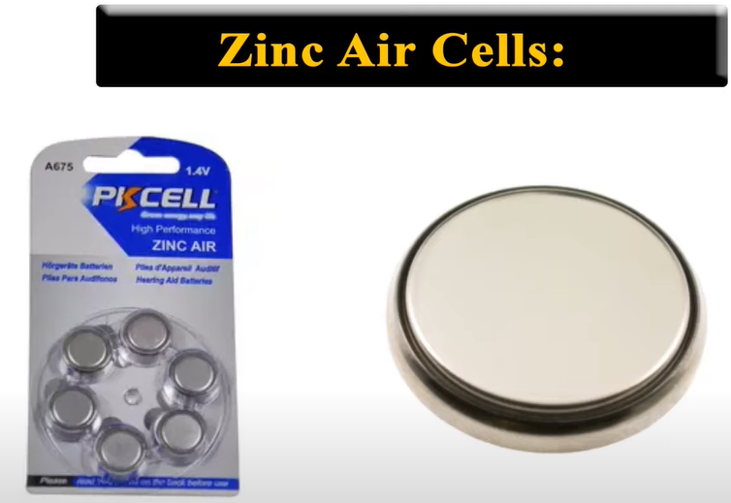
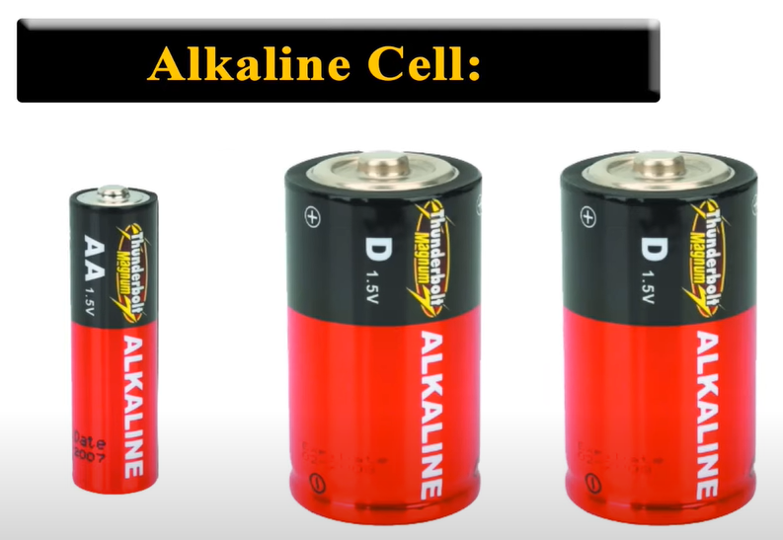

TYPES OF BATTERY - PRIMARY
A primary battery is a disposable kind of battery. Once used, it cannot be recharged.

Slide 3
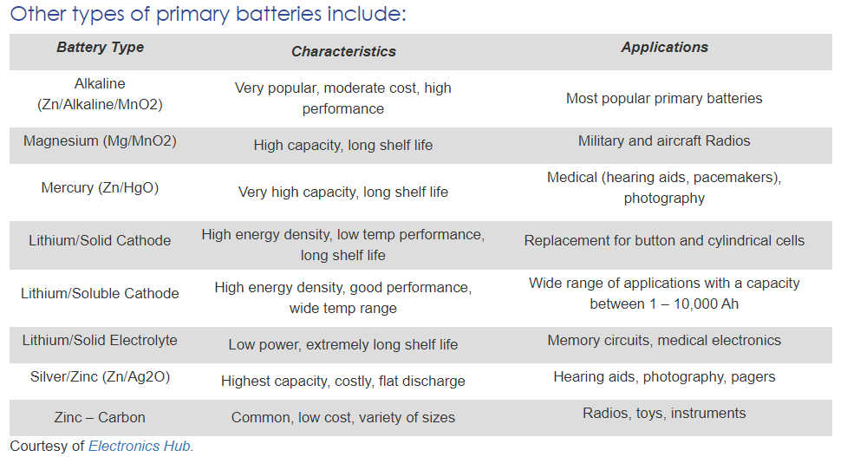
TYPES OF BATTERY - PRIMARY
A primary battery is a disposable kind of battery. Once used, it cannot be recharged.

Slide 4
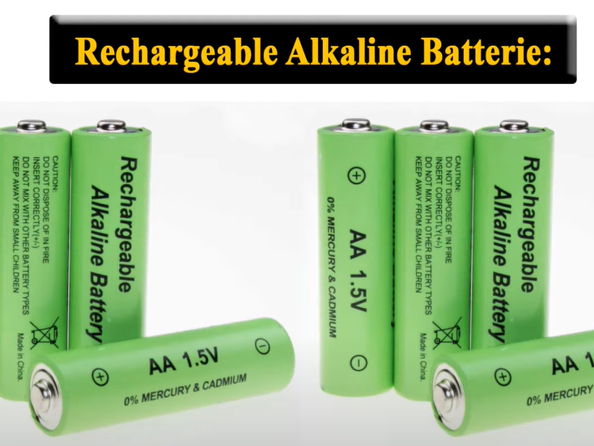
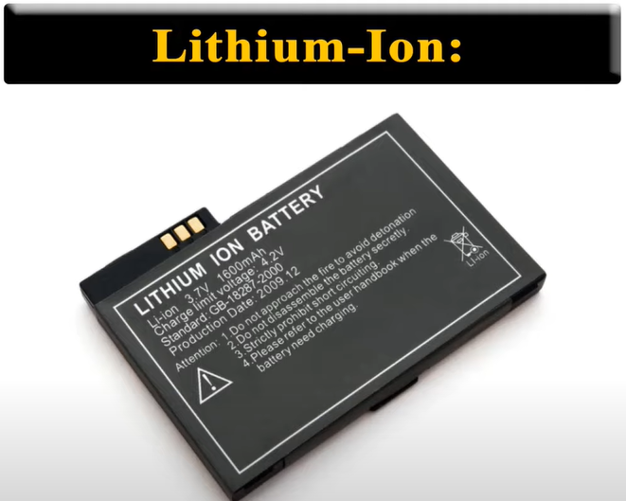
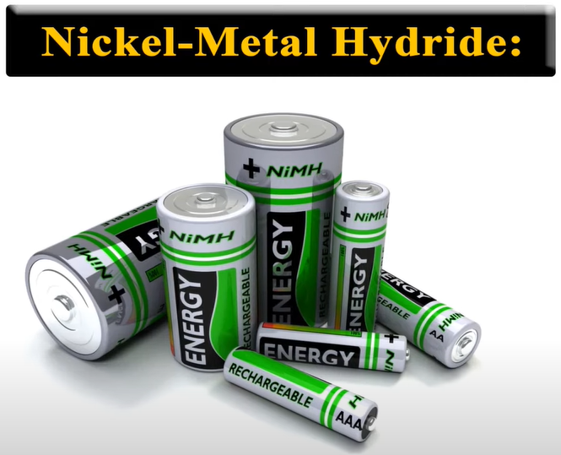
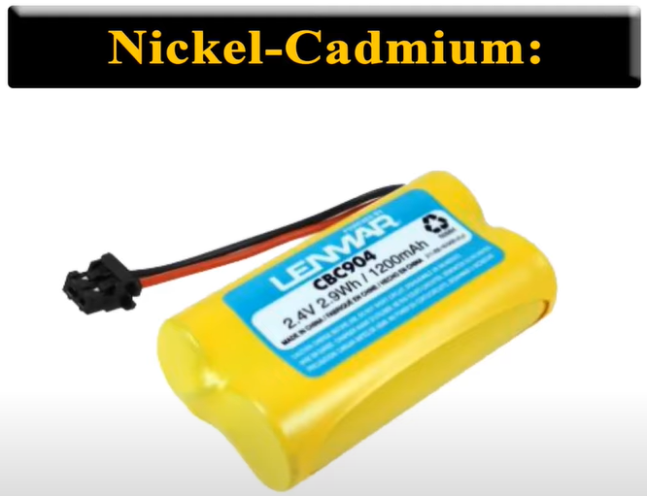
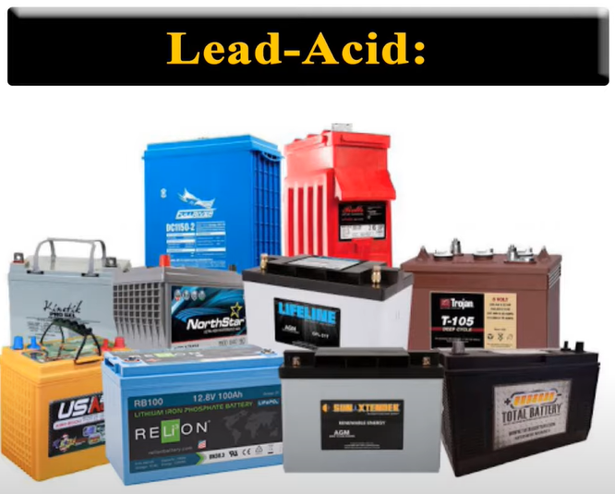
TYPES OF BATTERY - SECONDARY
Secondary batteries are rechargeable batteries. Once empty, it can be recharged again. This charging and discharging can happen many times depending on the battery type.

Slide 5
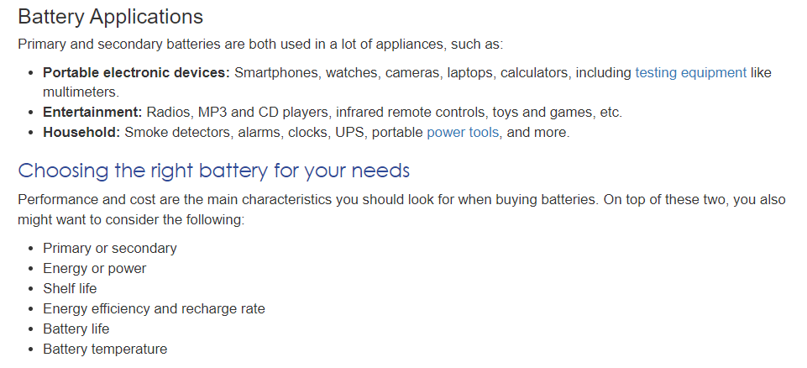
HOW TO CHOOSE BATTERY

Slide 6
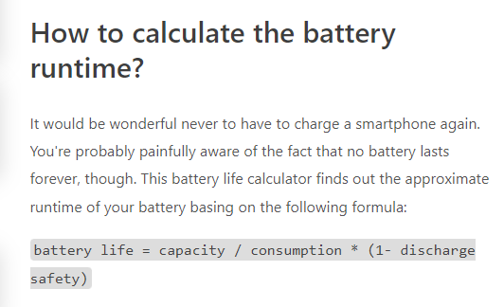
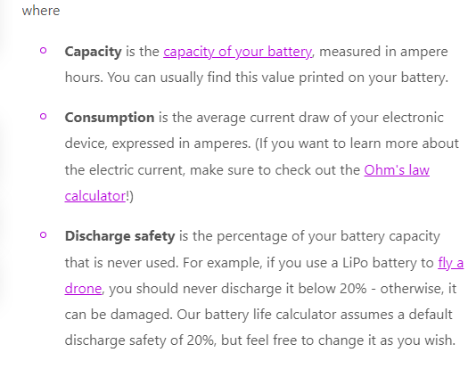
CALCULATING BATTERY LIFE

Slide 7
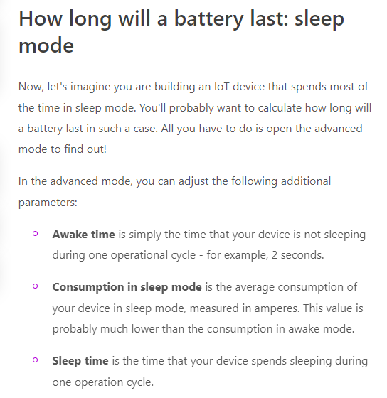
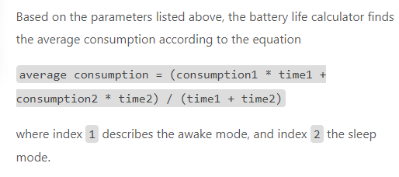
CALCULATING BATTERY LIFE

Slide 8
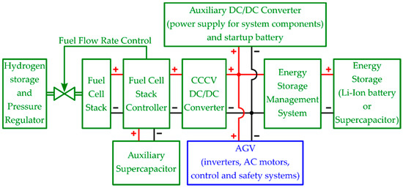
EXAMPLE:
AGV POWER MANAGEMENT SYSTEM

Slide 9
EXAMPLE:
AGV WIRELESS CHARGING
What is Wireless Charging?
With an inductive wireless charging system AGVs and AMRs can perform contactless battery opportunity charging.
The system counts on a stationary active fixed coil on the floor or on a wall and on a mobile passive coil on the mobile robot.
The active coil generates a magnetic field that induces an alternated current in the mobile coil. This current is used to charge the mobile robot battery.

Slide 10
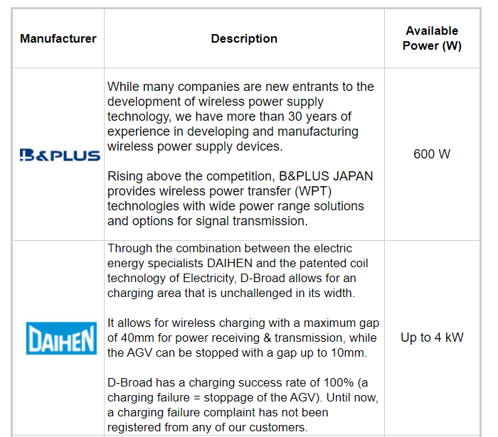
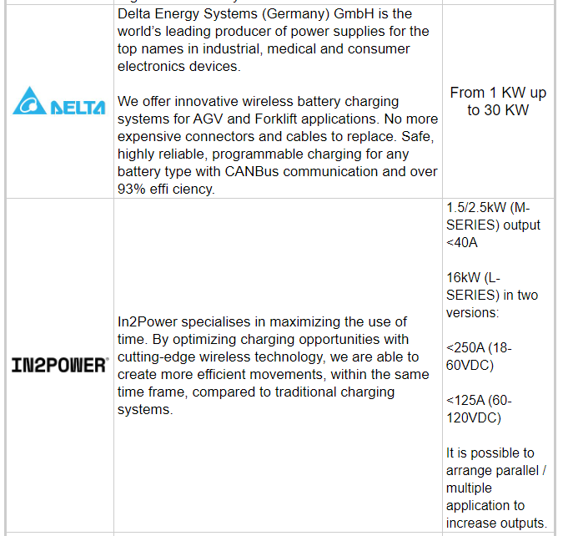
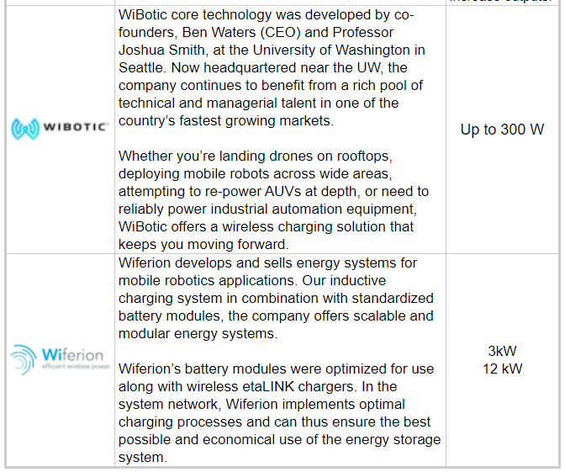
EXAMPLE:
AGV WIRELESS CHARGING
The main AGV and AMR Wireless Charging Systems manufacturers are:

Slide 11
EXAMPLE:
AGV WIRELESS CHARGING
The types of AGV charging system are:
Opportunity charging, for mobile robots, permits batteries to be charged several times during its working hours. The autonomous mobile robot or AGV goes to defined charging stations and performs charging while waiting for a new mission to be delivered. If the battery balance is properly calculated, the vehicle could never need a change of battery.
Battery swap. The mobile robot works with a single battery until it is fully drained that need to be swapped with a fully charged one. Battery swapping can be done manually or automatically as needed or on a schedule.
Wireless charging can only be used with the first strategy, which is opportunity charging. Opportunity charging can be performed with the classical “contact charging” method or with the newest “contactless charging”

Slide 12
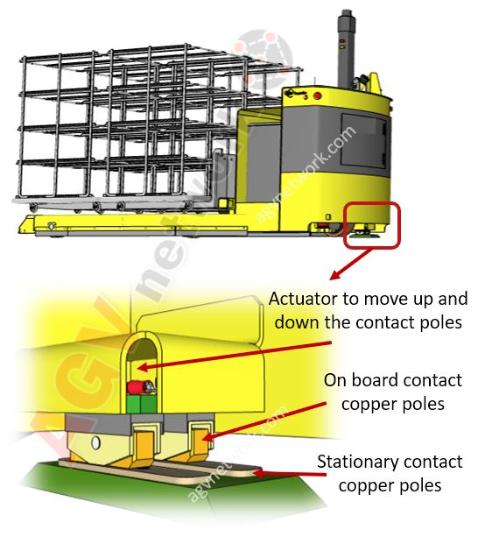
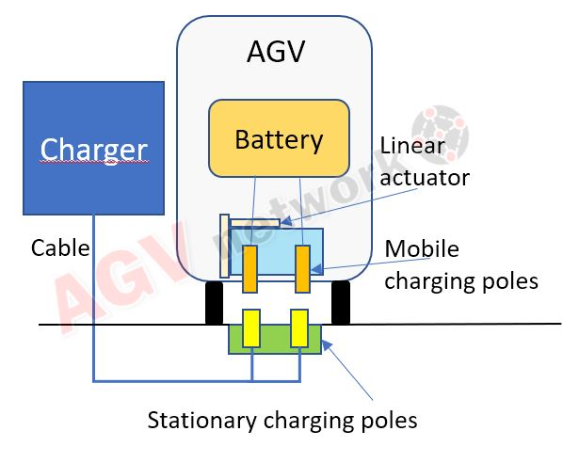
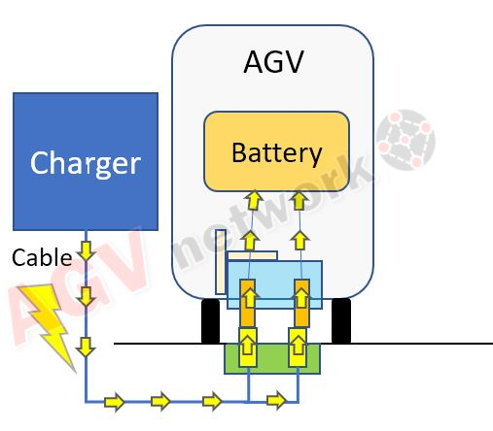
EXAMPLE:
AGV WIRELESS CHARGING (CONTACT)
The agv with the onboard charging poles arrives to the charging station. The charging station is composed by the stationary contact poles and the charger. The AGV moves down the contact poles, in general, tanks to a linear actuator.
The poles (onboard and stationary) touch. The charger verifies the voltage differential and starts the charging cycle.

Slide 13
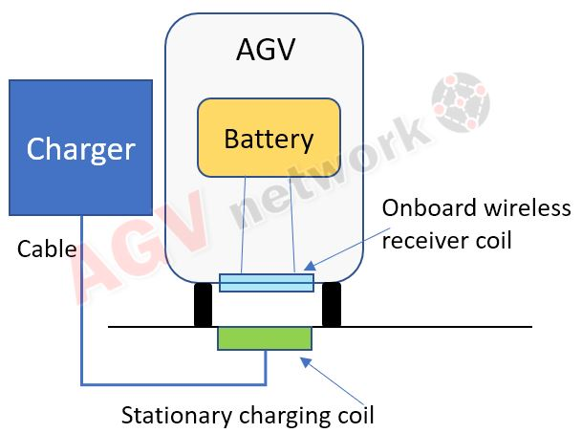
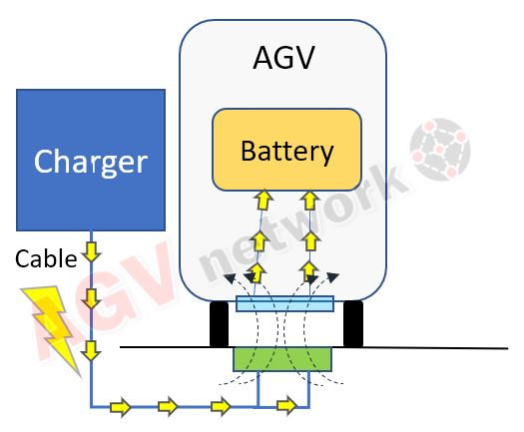
EXAMPLE:
AGV WIRELESS CHARGING (CONTACTLESS)
The agv with the onboard charging "coil" arrives to the charging station. The charging station is composed by the "stationary coil" and the charger.
As soon as the onboard coil and the stationary coil overlap, the power is "magically" transferred without any contact thanks to the inductive principle.

